Slide 1
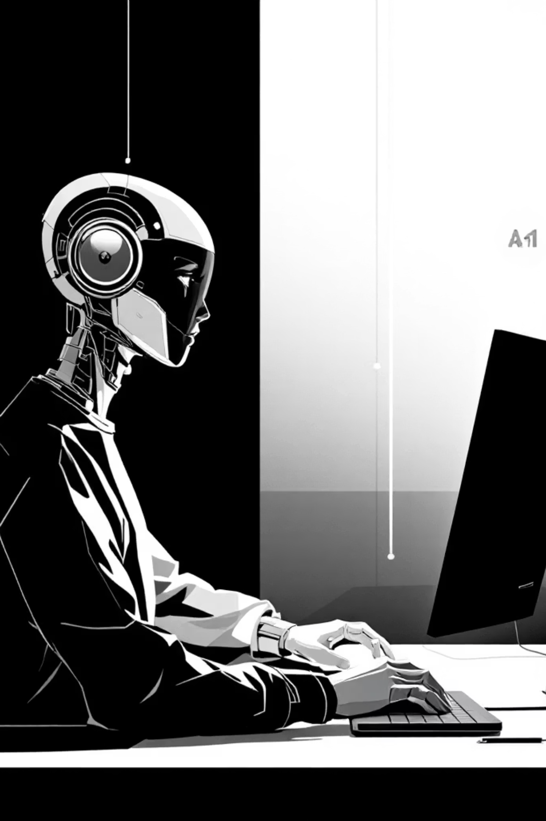
AI Native Software Engineering
(AINSE)- What changes when AI Starts Developing Softwares?
Presented by: Sahil Dua, Sunayana Hazarika

Slide 2

What is AINSE?
Scan the QR Code for the executive brief

Slide 3
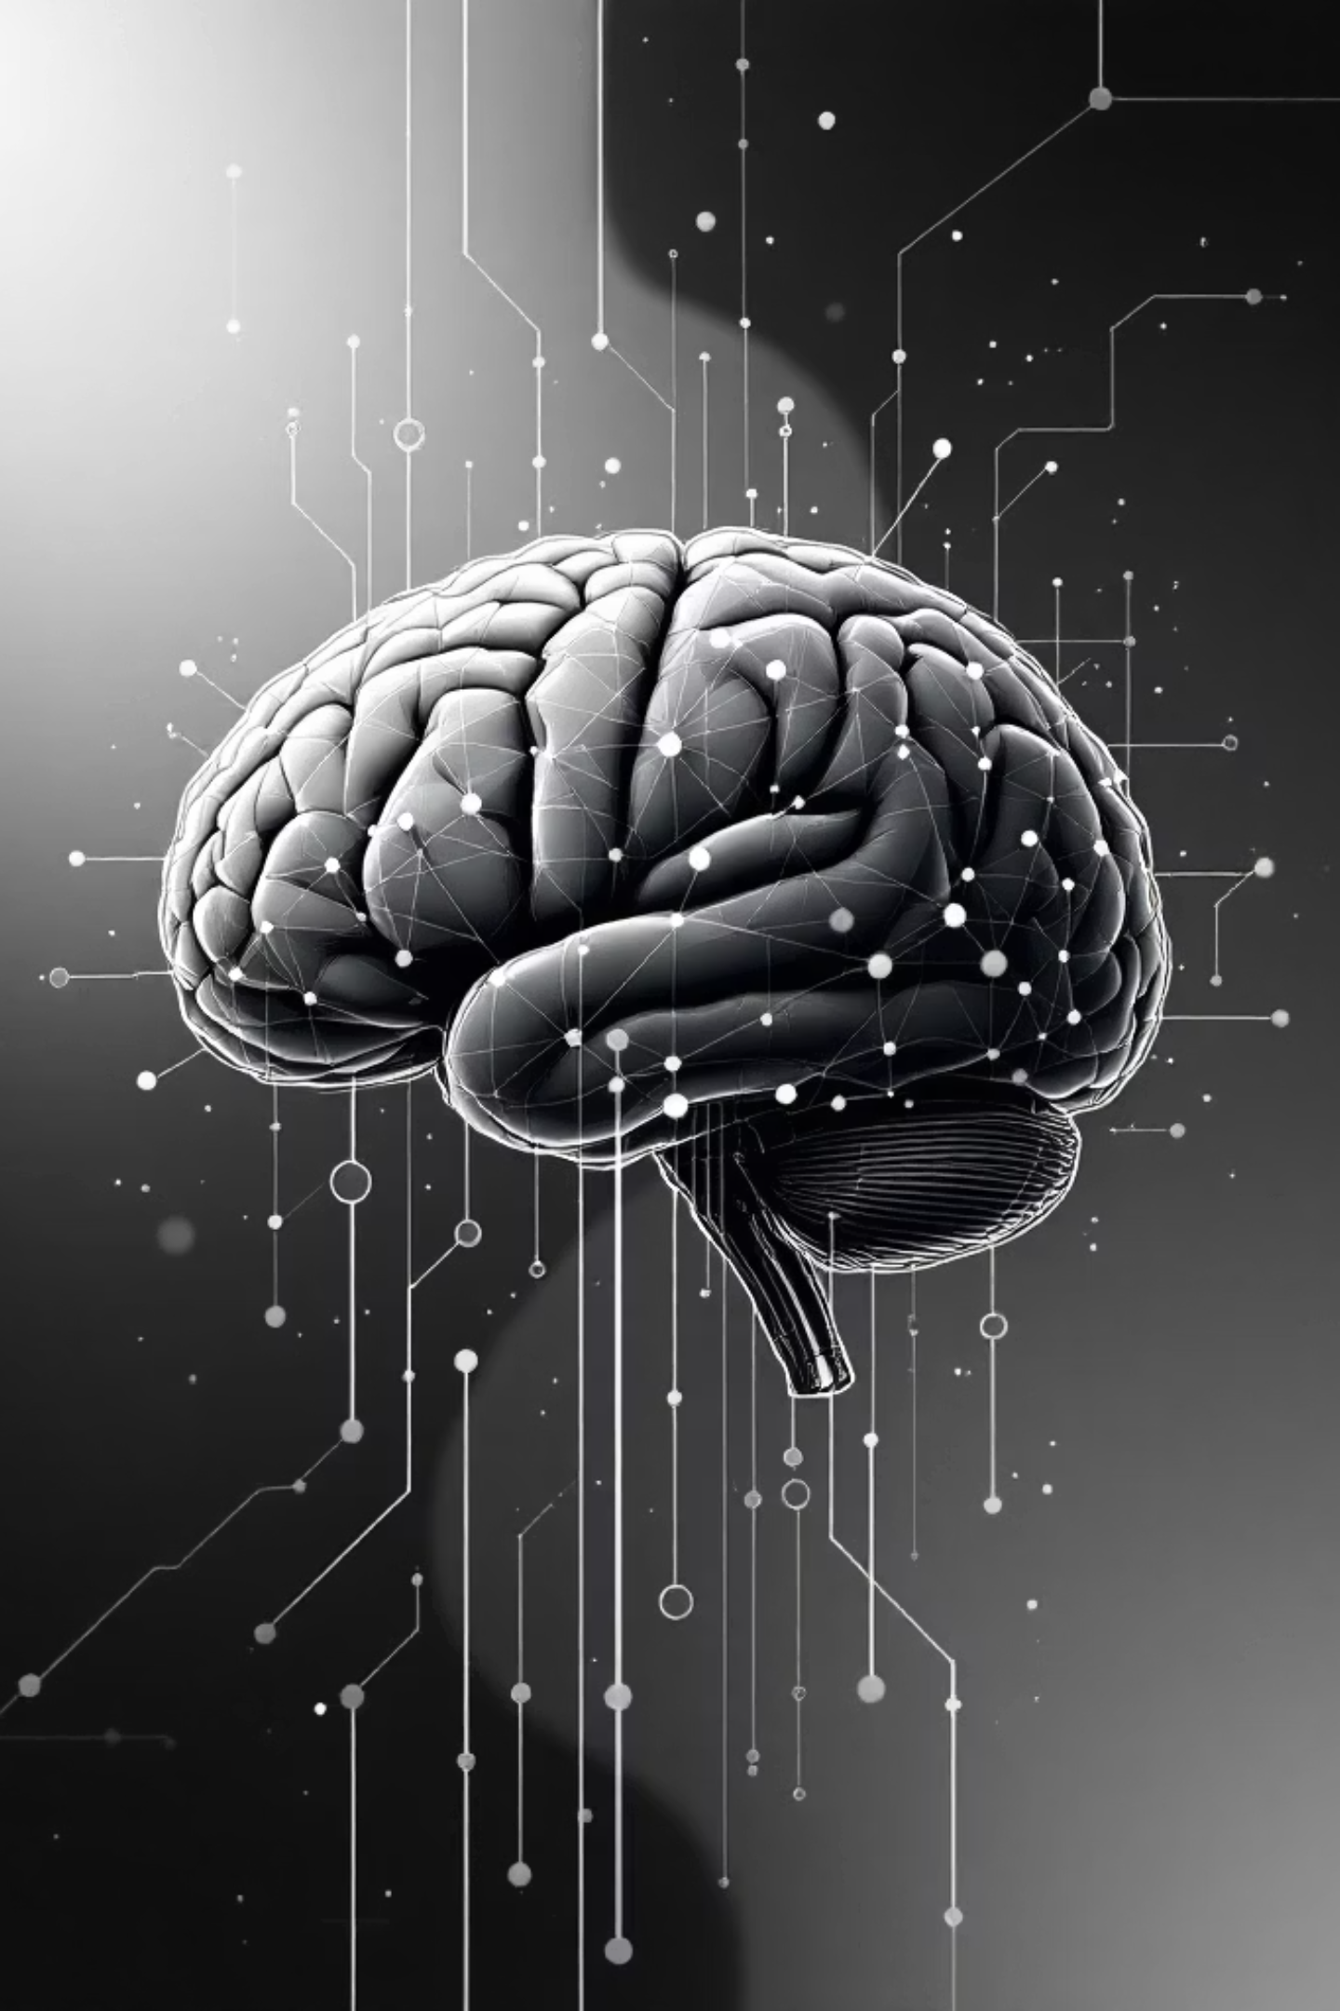

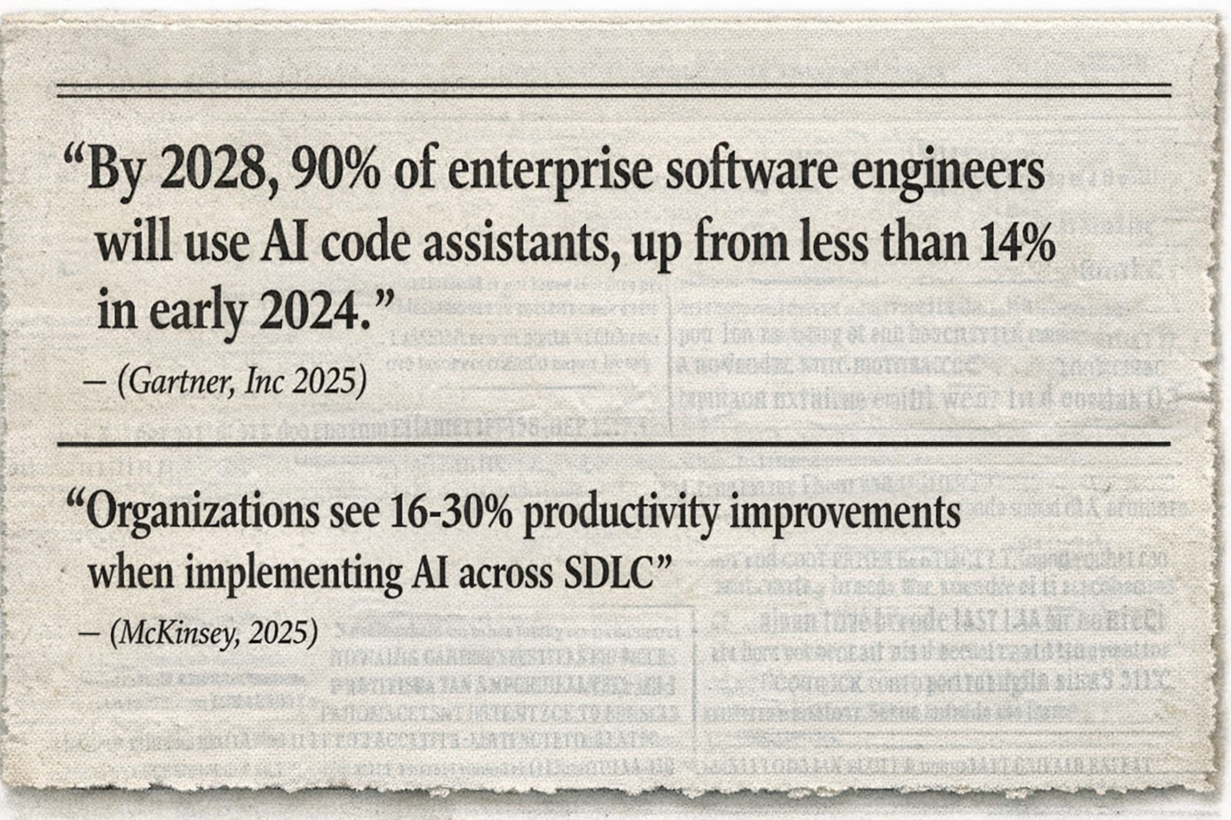
AI in Development?
We are entering an era where software writes software.

Slide 4
The Business Problem
Pressure:
Release faster with fewer engineers
Industry reality: 79% report software release missing timelines (Forrester 2024)
Reality:
Speed gains offset by rework, defects, and security risk
GenAI copilots increase output, but code duplication and maintainability rise risk (McKinsey research)
The Real Risk Isn’t Bad Code - It’s Ungoverned Decisions
When GenAI shifts from suggesting to deciding:
Control shifts From human approvals → policy + automation
Accountability blurs Who owns an AI-made decision?
Errors compound One agent’s output feeds another

Slide 5


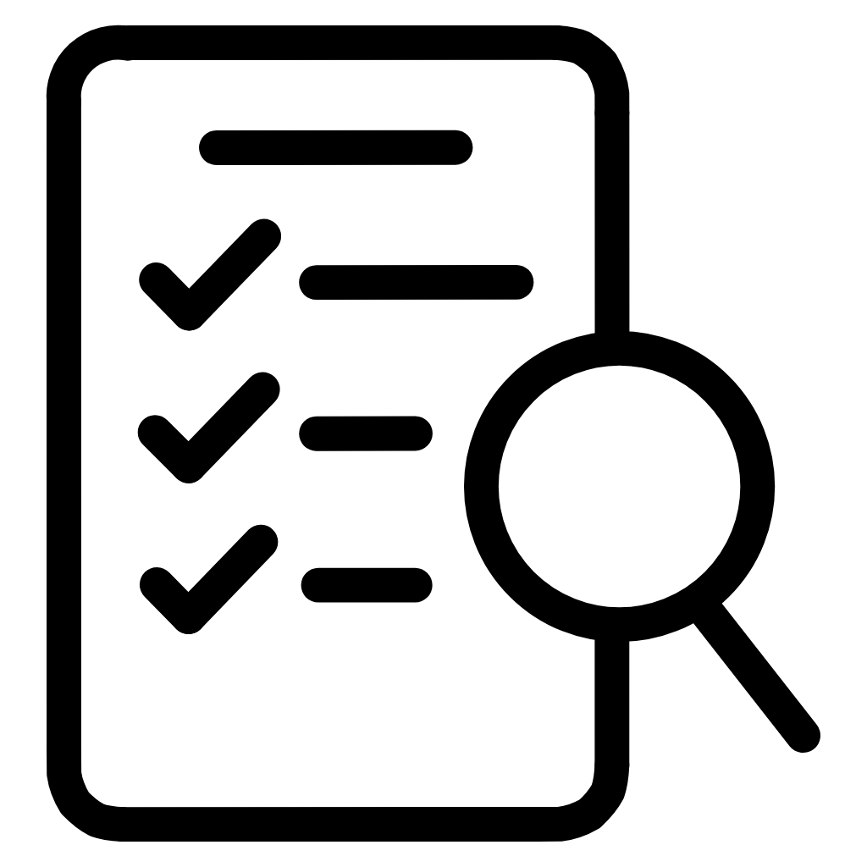




AI Applications Across Development
Code Generation
Bug Detection
Autocompletion and synthesis from natural language descriptions
Automated analysis and real-time correction suggestions
Testing Automation
Architecture Design
Intelligent test case generation and optimization
Optimal system designs based on requirements
Documentation
Security Enhancement
Auto-generated API guides and code explanations
Vulnerability identification and mitigation strategies

Slide 6





AI Transforming the SDLC
Requirements
Natural language processing converts ideas to specifications
Design
Architecture suggestions and UI mockups generated instantly
Development
Code generation and real-time assistance accelerates coding
Testing
Automated test generation improves coverage and quality
Deployment
CI/CD optimization predicts failures and reduces downtime

Slide 7
Strategic Recommendation
Pilot
AI TRiSM with Decision Gate
Scale
Bias Mitigation
Use diverse training data and conduct regular fairness audits to prevent discriminatory outcomes
Human Oversight
Maintain manual coding skills and conduct security reviews of AI-generated code
Transparency
Apply interpretable models and clear documentation protocols for accountability
Workforce Development
Invest in reskilling programs to transition roles toward AI collaboration and oversight
The biggest ROI isn’t “coding faster.” It’s reducing the hidden tax of rework + reliability + security debt created when autonomous

Slide 8

The Evolving Role of a Developer
From Coder to Orchestrator
AI enables developers to co-create, shifting their role from writing every line of code to orchestrating intelligent agents - defining direction, setting constraints, and enforcing quality gates while agents handle execution.
New Responsibilities
Guiding AI-generated outputs and ensuring quality
Managing AI integration across development workflows
Refining technical requirements and specifications
Overseeing system architecture and integration
Strategic decision-making and optimization
AI-native engineering is inevitable. Un-governed autonomy is optional.

Slide 9
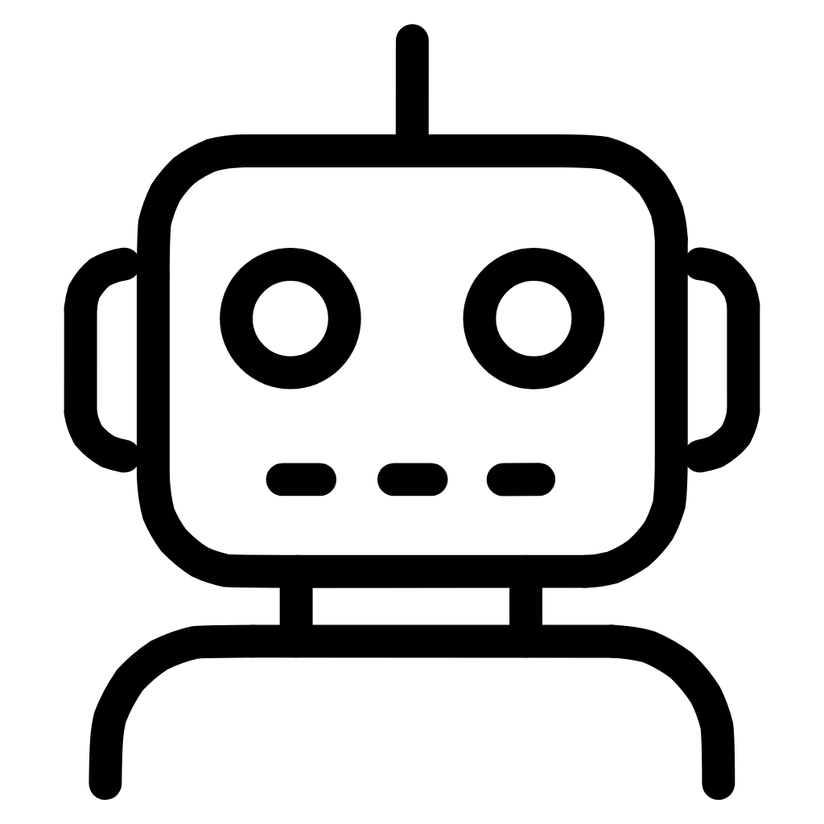



Key Benefits
Automation
Improved Quality
AI automates repetitive work allowing developers to focus on higher-value design and decisions.
Early bug detection, comprehensive testing coverage, and optimized code reduce vulnerabilities and errors.
Accelerated Delivery
Democratization
Faster development cycles, quicker time-to-market, and rapid iteration based on accurate predictions.
No-code/low-code platforms enable non-technical users to build AI-powered applications with ease.

Slide 10

Thank You!

